Slide 1
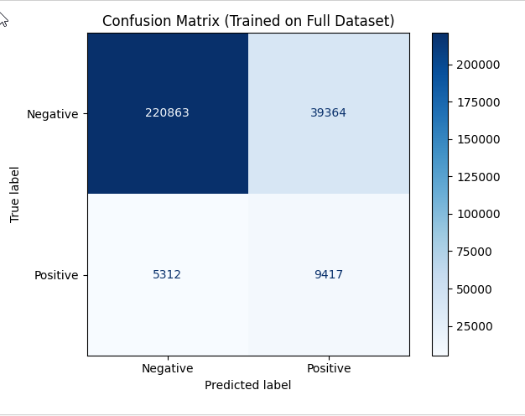
COVID-19 Screening Using Symptom Data
Problem Framing and Objective
Screening COVID-19 using self-reported symptoms to prioritize individuals for further testing or care.
Class Imbalance Challenge
Only 5.4% positive cases create difficulty in model training and evaluation due to data imbalance.
Modeling Approach
Logistic Regression chosen for interpretability and probabilistic outputs aiding healthcare decision-making.
Model Purpose and Use
Designed as a screening tool to flag potential cases, not for definitive diagnosis.

Slide 2
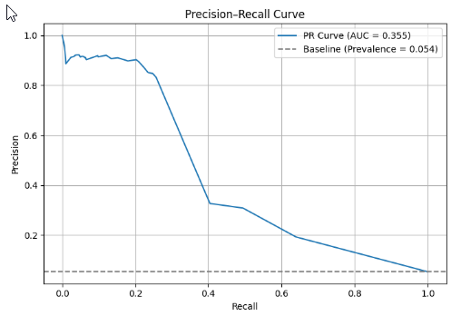
Handling Class Imbalance Effectively
Preprocessing for Imbalanced Data
Target labels were cleaned and encoded into consistent binary format for accurate modeling. Feature selection focused on realistic symptom indicators available during screening.
Limitations of Accuracy Metric
Accuracy is misleading for imbalanced data as it may favor the dominant class while ignoring minority positives. Alternative metrics are necessary.
Use of Precision, Recall, and F1 Score
Evaluation focused on precision, recall, and F1-score to balance identifying positive cases with minimizing false alarms in classification.
PR-AUC as Primary Metric
PR-AUC was chosen for its suitability in ranking positive cases above negatives, with baseline reflecting positive class prevalence

Slide 3
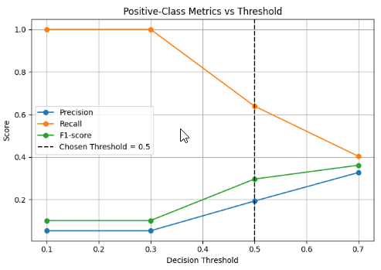
Final Outcome and Threshold Evaluation
Threshold Evaluation
Multiple thresholds were evaluated to balance recall and precision in logistic regression outputs.
Selected Threshold Rationale
Threshold 0.5 was chosen as the operational point, balancing recall of 64% with precision of 19%.
Model Effectiveness
The model's PR-AUC exceeded baseline prevalence, confirming meaningful symptom data signal capture.
Visual Decision Support
Precision, recall, and F1-score are plotted to clarify the threshold selection to stakeholders.

